Slide 1
Trustworthy Hackathon
Lucas, Chloe, Daivya, Eric

Slide 2
Our Mission
In today's digital marketing landscape, the ability to precisely target advertisements is essential for maximizing user engagement and conversion rates. Our mission is to discovering useful information from data, leverage machine learning to analyze an extensive dataset, develop predictive models, and generate synthetic data to improve the accuracy and efficiency of ad targeting.

Slide 3
Part 1: Data Security

Slide 4
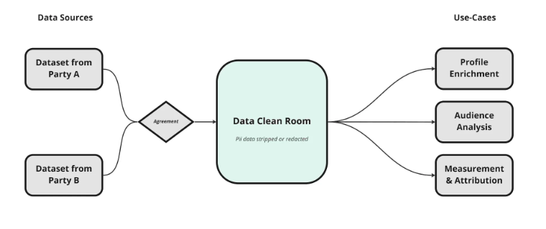
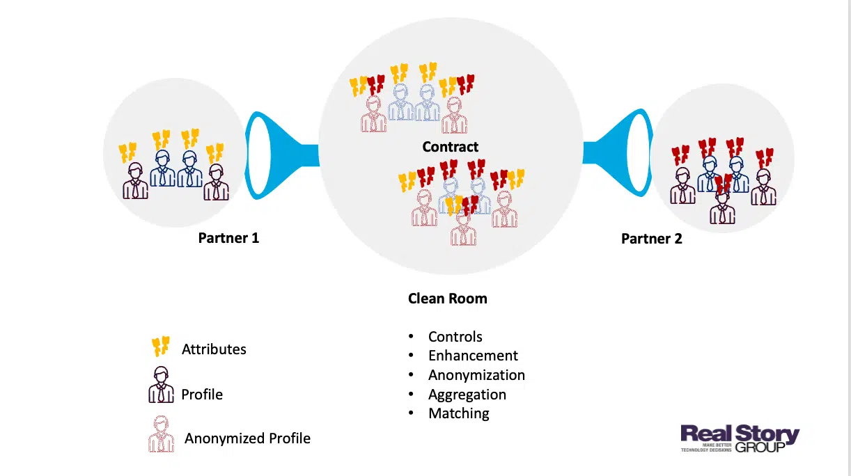
Protecting Data in Use
Confidential Computing - Currently, there is a vast array of methods to protect data in storage or at rest, but there remains a gap when it comes to protect data in use. Our goal is to navigate an application of confidential computing in a multi-party data sharing scenario.
Goals - Protect data in use by ensuring the confidentiality and integrity of the code and the environment
Purpose - To provide a secure and confidential data sharing platform. In this case, the platform will allow for publishers and advertisers to confidentially combine their data together to extract machine learning insights without having their customer data leaked to the other party or accessed by malicious actors

Slide 5
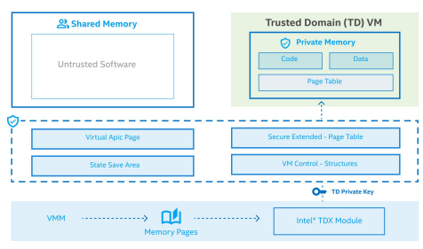
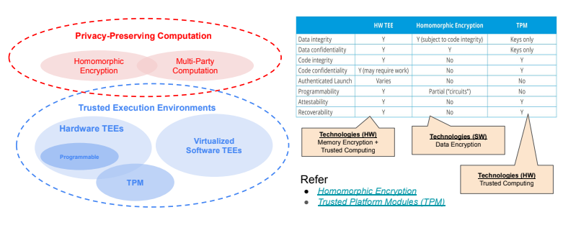
Technical Analysis
Resources/Technologies
Azure Confidential VM - Provides a secure Ubuntu environment to run operations. Azure Confidential VMs provide numerous security benefits such as Intel TDX and TPM capabilities, isolation and data confidentiality. Also Azure products allow for immense scalability.
tpm2-tools library - Allows for attestation utilizing the TPM. Can create endorsement keys to attest for the TPM itself and an attestation key to attest for the evidence. Also provides tools aiding with the modification and evaluation of PCR values and quote creation and verification
Azure Key Vault - Provides a safe remote server to store keys. Can securely transport these keys through the Amazon CLI as they utilize TLS.
Azure Storage Containers - Allows easy and secure transfer of files between confidential VMs. Easily scalable storage
Implementation - Please see the markup file in this GitHub Repository for an in depth explanation of the implementation described above https://github.com/ChloeHouvardas/CC-TPM-Attestation/blob/main/instructionsRoundTwo.md
Intel TDX Utilized by Azure’s Confidential VMs

Slide 6
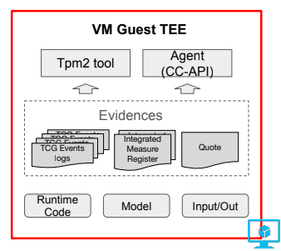
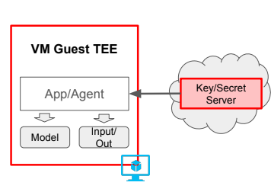

Technical Implementation Steps
Setup Azure Confidential VMs (one for TEE one for remote attestation server
Download tpm2-tools on both VM
Send Encrypted Resources to TEE (via scp)
Create endorsement key (verifies root of trust) and use it to make attestation key
Collect evidence
Calculate hash for code and data
Entend to PCR
Create quote
Send quote to remote attestation server VM using azure storage
Verify quote
Switch to attestation server VM
Download quote from azure storage
checkquote
If valid, send decryption key to TEE
Decrypt data, run models
Use the decryption key and the decrypt.py script to decrypt data
Run models on data
Output insights and synthetic data
Encrypt data

Slide 7
Part 2 Task 1: Data visualization

Slide 8
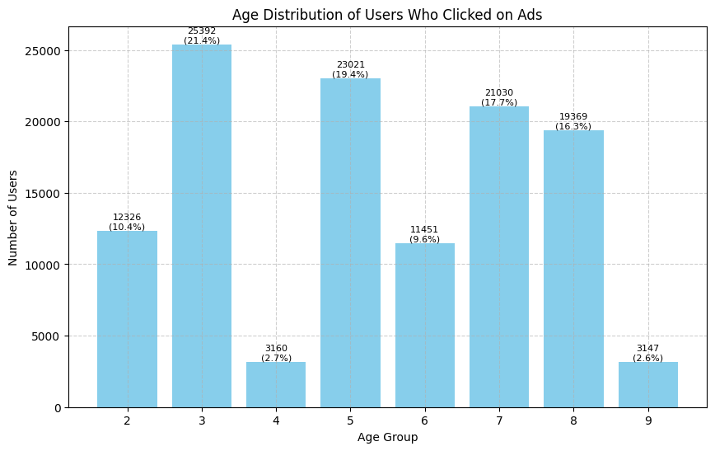
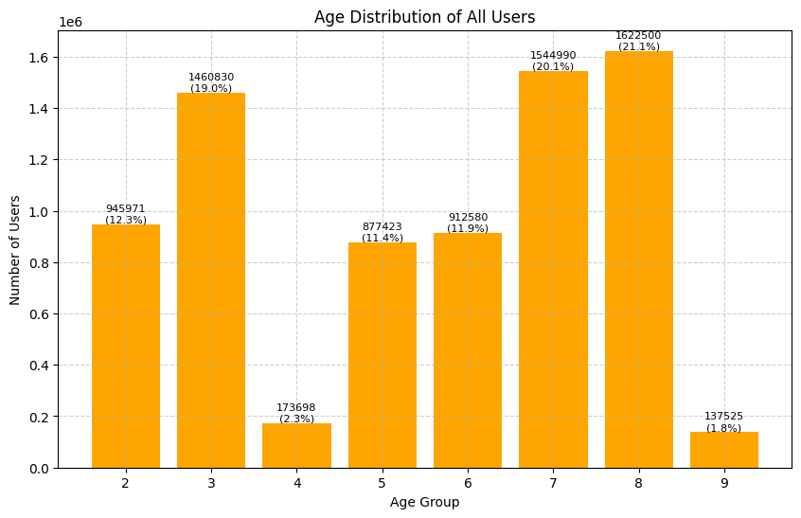
Data Visualisations
Age Group Distribution
The age group distribution for users who clicked on ads shows that the most responsive groups are Age Group 3 (21.4%), Age Group 5 (19.4%), Age Group 7 (17.7%), and Age Group 8 (16.3%).
This suggests that advertisements should be primarily targeted towards these age groups to maximize engagement. By focusing on the most responsive age groups, ad agencies can enhance the effectiveness of their campaigns and achieve better conversion rates.

Slide 9
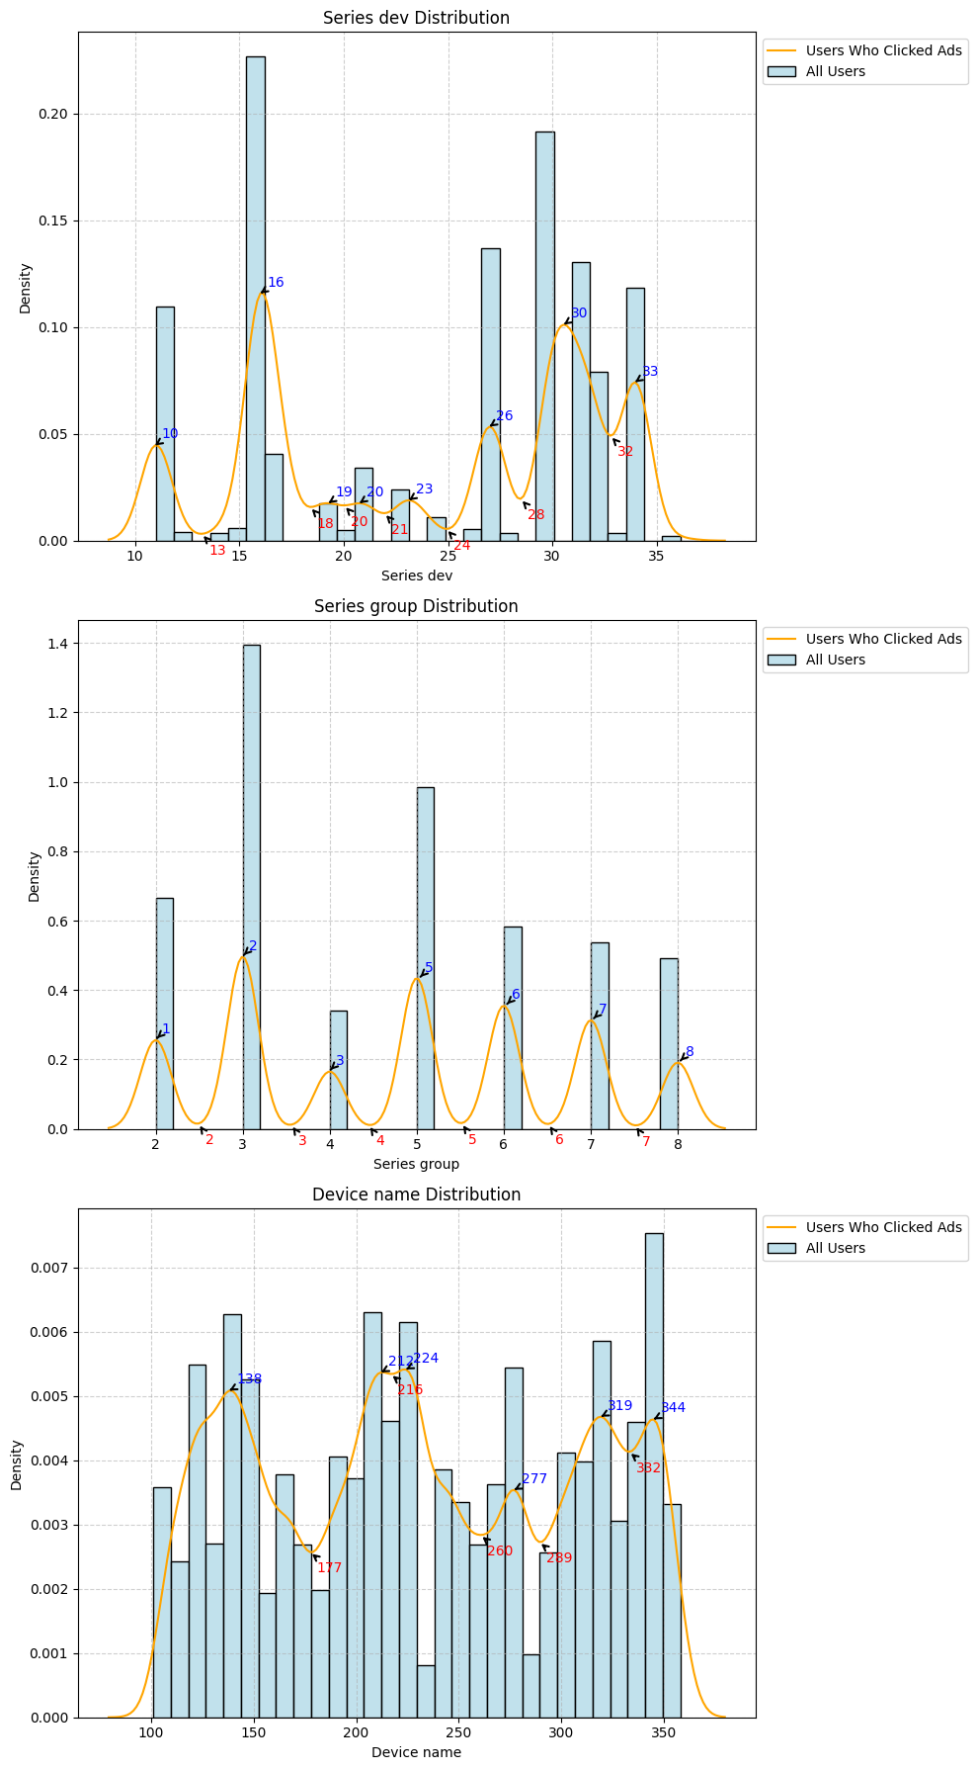
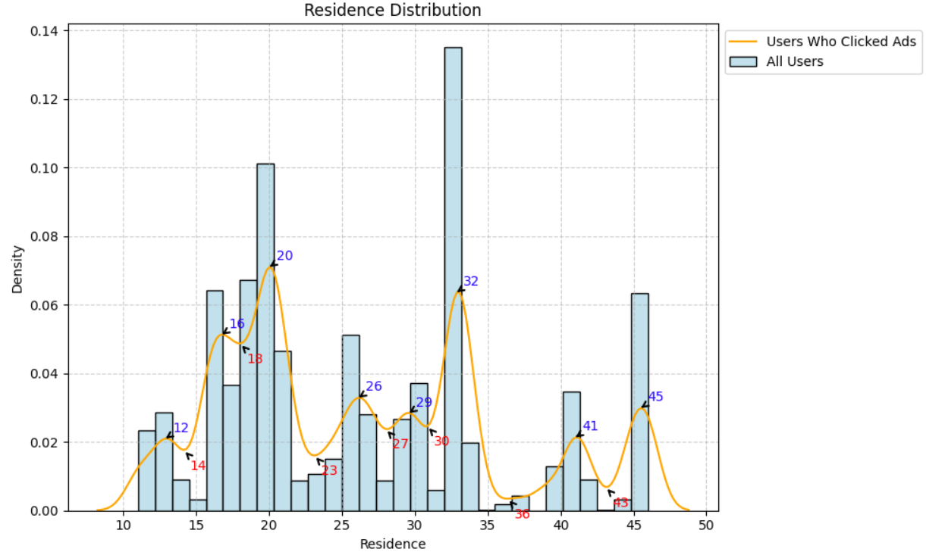
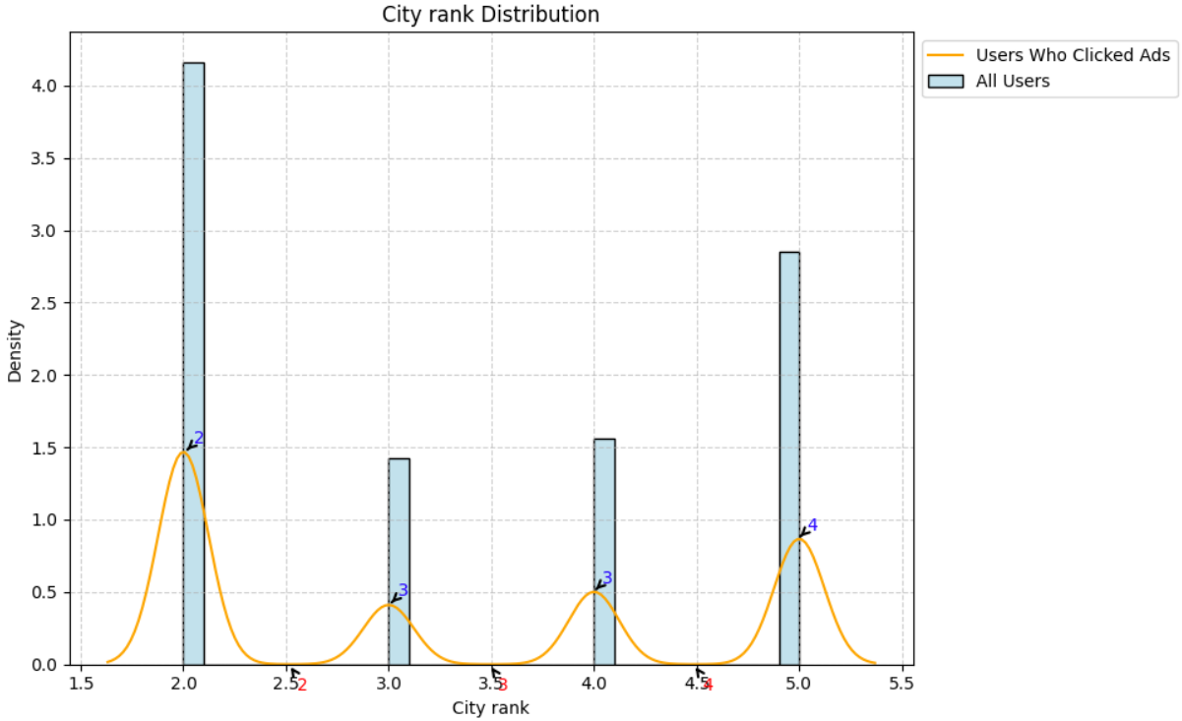
Data Visualisations
Geographic Distribution and Device Usage
The geographic distribution analysis reveals that users in residences around 20 and 32, city 319, and city ranks 2 show higher ad engagement compared to the overall user base.
Users who click on ads prefer specific device characteristics: series_dev IDs 16 and 30, series_group ID 2, emui_dev ID 20, device_name IDs 138, 224, 344, device_size 2113 and 2405, and net_type 7. Targeting these characteristics can enhance ad effectiveness.

Slide 10
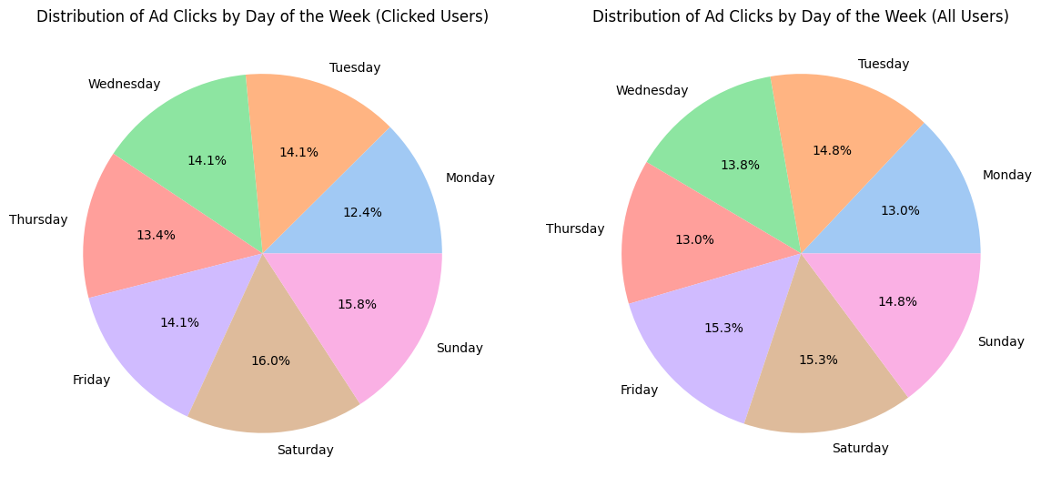
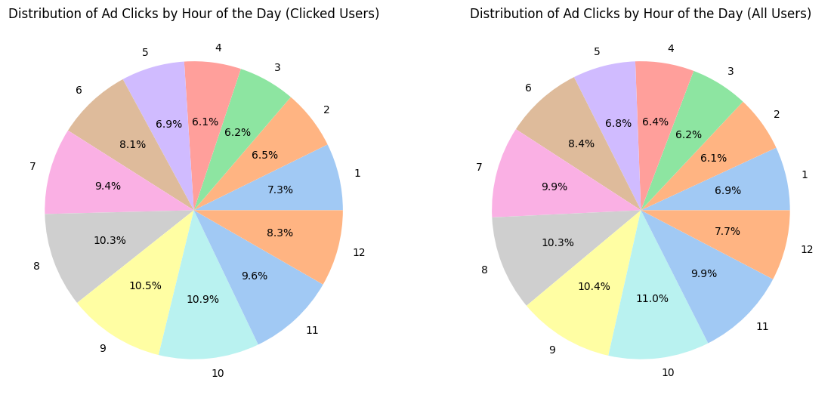
Data Visualisations
Engagement Patterns
Users click ads most on weekends, peaking at 16.0% on Saturday and 15.8% on Sunday. Weekday activity is balanced, with Monday at the lowest (12.4%). Ad clicks peak between 8 PM and 12 AM, especially at 10 PM (10.9%) and 11 PM (10.4%).
These insights suggest that ad campaigns should be scheduled to maximize visibility during these high-engagement periods, particularly on weekends and during evenings to nights, to optimize user engagement and ad performance.

Slide 11
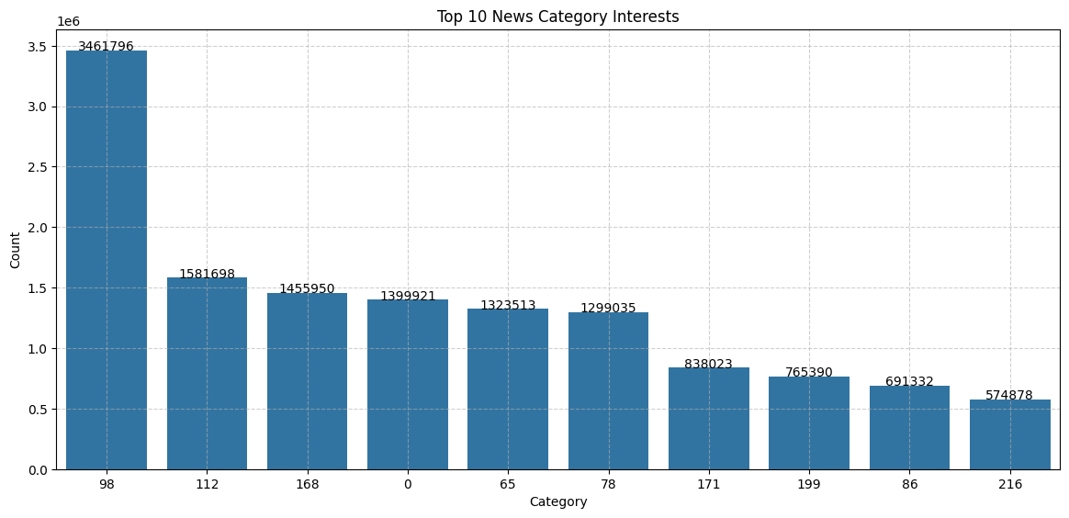
Data Visualisations
Content Preferences
Category 98 is the most popular with 3.46 million users, followed by categories 112 and 168 with 1.58 million and 1.46 million users, respectively.
Aligning ad content with these popular categories can increase click-through rates and user engagement.

Slide 12
Part 2 Task 2: Model Prediction

Slide 13

Data Cleaning
Featured_dataset.ipynb : this file clean the data, endow features to the data and create 2 csv file
Predict.ipynb: This file performs the data slicing, model training and provides answer to your question
Merging - Merging ads and feeds by variable user_id.
Variable featuring - give feature “clicked” to determine if the user interacted with the ads.
Variable Dropping - Dropping many variables from the dataset, they are either very biassed; they are duplicated; they are identifier(ids); they have too many unique value. (timestamp, city and residence)
Column Dividing - Splitting the column into multiple columns(like 23151^231^214^123, I separate this long list to multiple column. I think the numerical number could represent certain category, and after ^ is the subset of this category)

Slide 14
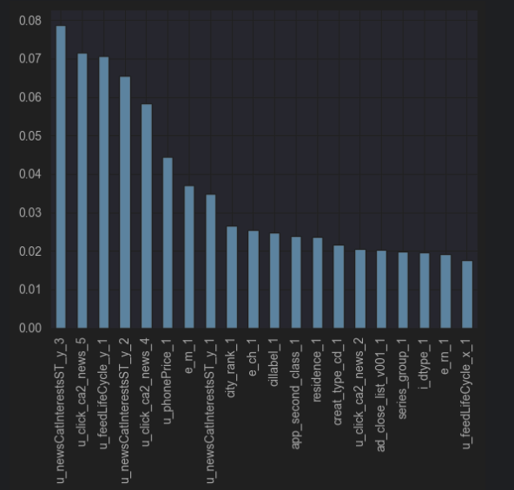
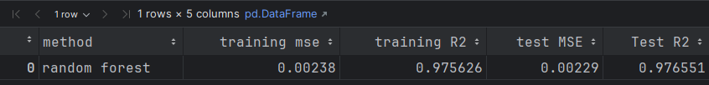
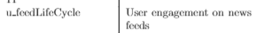
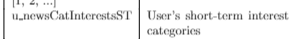

Some conclusion from the dataset
*This model only runs in a portion of the dataset (743,035 rows and 90 columns to be specific)

Slide 15
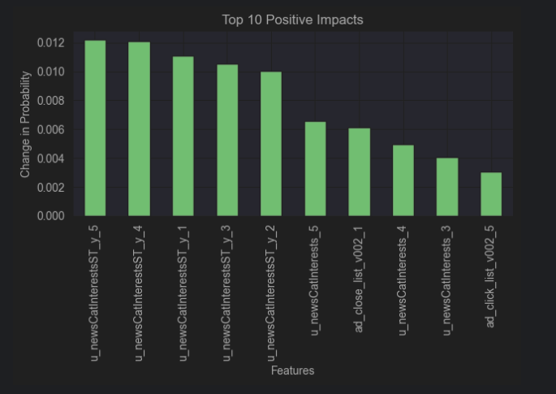
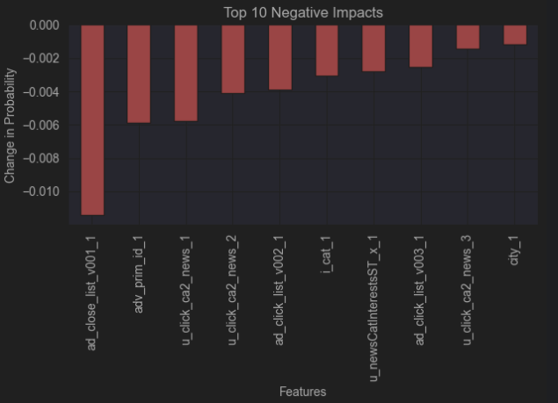
Can I Quantify the Correlation?
When increase X feature by 80%, how will it affect the click rate?

Slide 16
Part 2 Task 3: Generating synthetic data

Slide 17
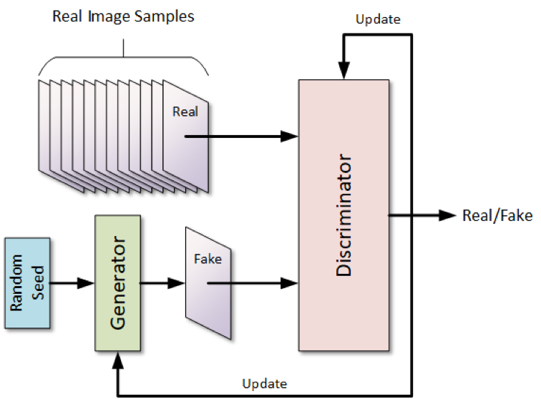
Overview
To create our synthetic data for confidentiality purposes a GAN model was used. This model took an input of the provided merged datasets. Only one dataset was made for the union of the two datasets as null points in non-clicked rows biased the model if set to 0. Due to the large size of the data sampling was done as to allow the model to train and not create memory errors. If possible the model can be adjusted to include the full data and increase number of epochs.

Slide 18
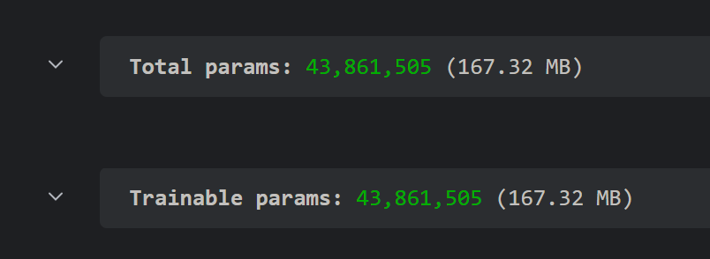
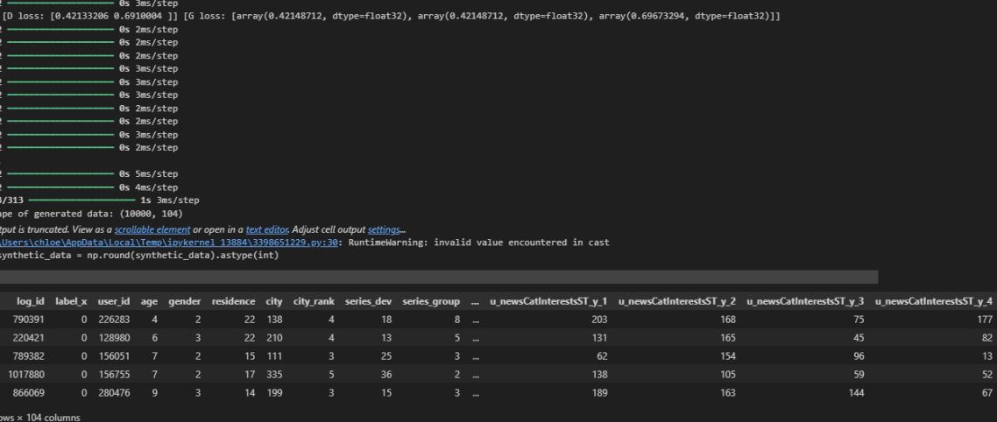
Generations
M1 treated all columns as categorical and used OneHotEncoder for each column creating an extremely high number of parameters.
Several generations were made to try and perfect the model, this included models that had changes to items such as: learning rate, layers, nodes, type of GAN, and the input data. Some of the highlights of the models are here.
M2 was changed to numerical input and had a high loss and low accuracy for both the Discriminator and the Generator

Slide 19
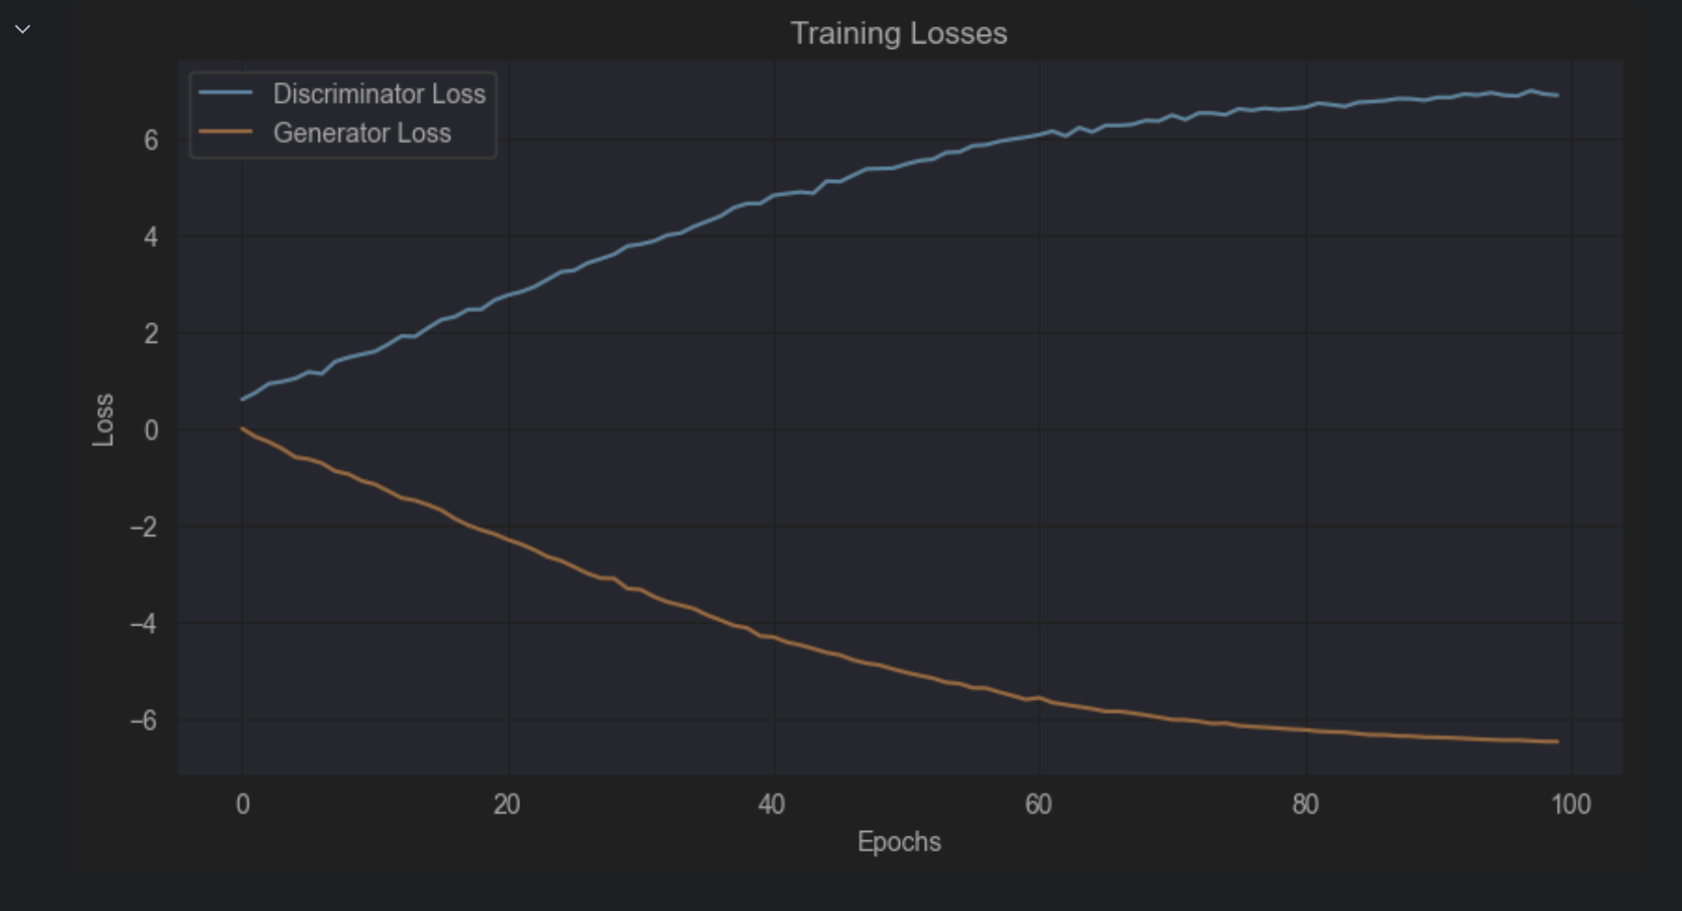
Generations cont.
M7 was a form of a Wasserstein GAN in attempts to combat mode collapse that was present in some of the synthetically generated data. It’s discriminator and generator diverged and the idea had to be scrapped.
M4 increased to 3 layers for the Generator and 2 for the discriminator. This model was plagued with an issue of destabilizing around 100-200 epochs and began to diverge, decreasing accuracy and increasing loss.

Slide 20
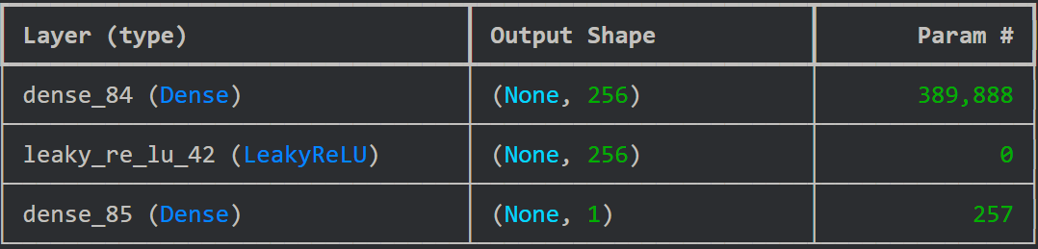
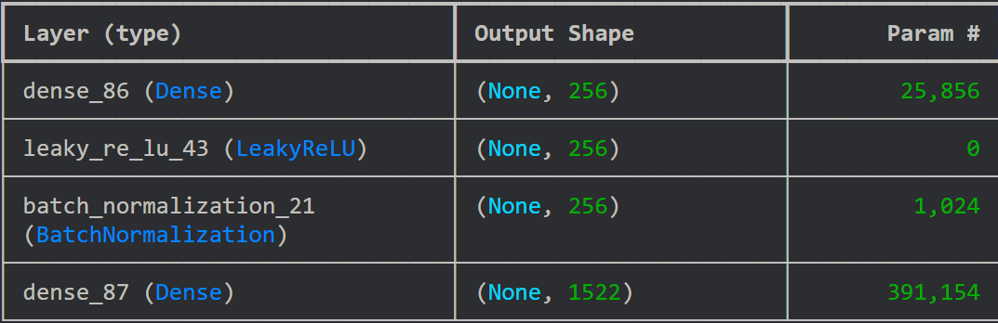
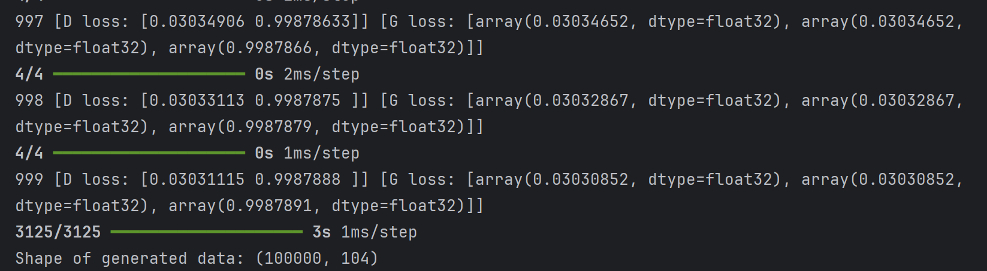
Final Model
Summary of Discriminator ^
and Generator (below)
The final model that was resulted was a 2 layer GAN whos strength lied in the efficiency. It did not diverge and had small enough inputs to run over many epochs. After 1000 epochs it had a resulting loss of 3% on each model and 99.8% accuracy.
Future improvements:
M4 had worse accuracy and loss but better data gen
Also generate the non click data

Slide 21
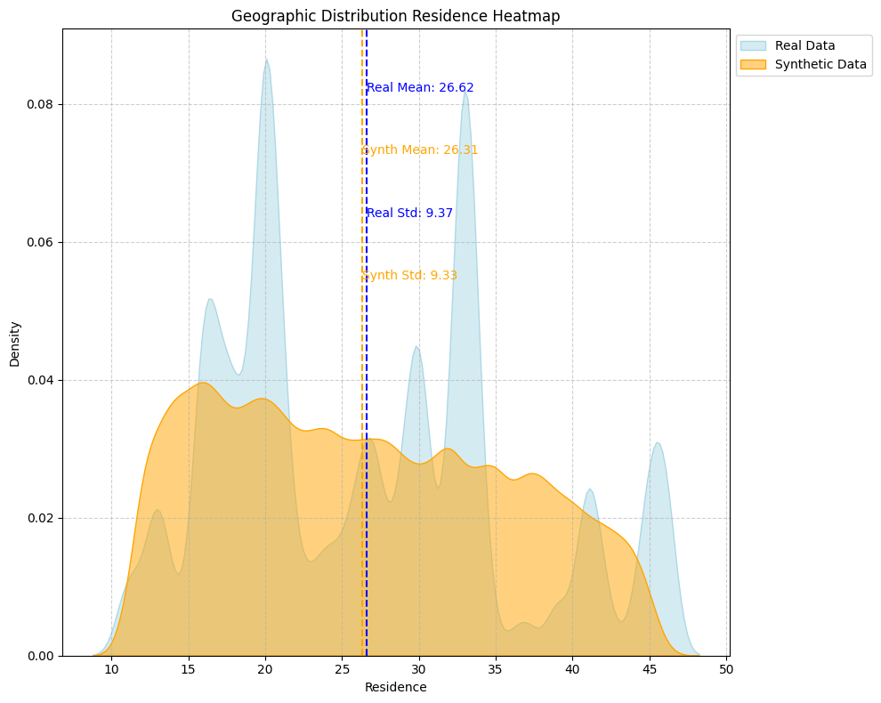
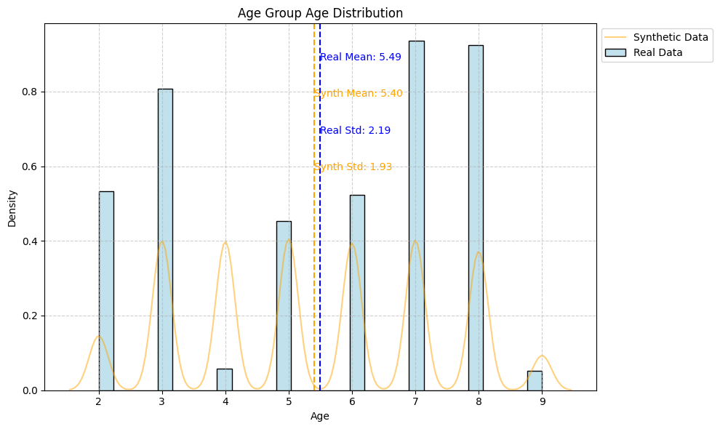
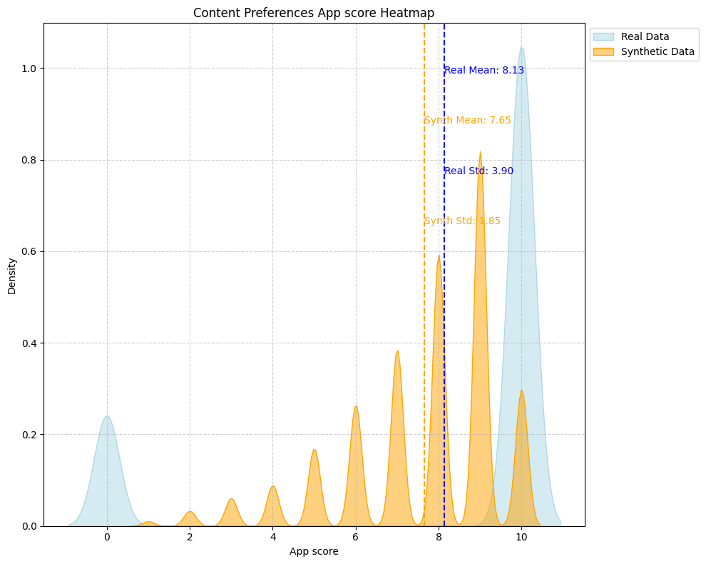
Real vs Synthetic
The synthetic data closely mirrors the real data across age groups, geographic distribution, and content preferences.
Age Groups: Synthetic data mean = 5.40, std dev = 1.93 vs. real data mean = 5.49, std dev = 2.19.
Geographic Distribution (Residence): Synthetic data mean = 26.31, std dev = 9.33 vs. real data mean = 26.62, std dev = 9.37.
Content Preferences (App Score): Synthetic data mean = 7.65, std dev = 1.85 vs. real data mean = 8.13, std dev = 3.90.

Slide 22
Thank you.

